Slide 1

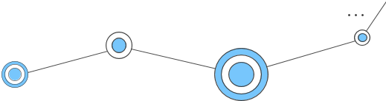
FPT APTECH HANOI
E-Project
Technology Product
Teacher : Nguyen Duy Hoang

Slide 2

Group Members
Bùi Minh Hiếu (Trưởng Nhóm)
Nguyễn Như Vũ
Lê Quang Huy
Đinh Công Minh
Đặng Văn Long

Slide 3
Introduction
Problem: Difficulty applying IT concepts in practice.
Reason: Busy schedules, limited access to real-world scenarios.
Solution: Aptech's live eProject platform.
Benefit: Synchronous, hands-on learning in a simulated environment.

Slide 4
Technology
01
HTML
02
CSS
03
JAVASCRIP
05
REACT JS
04
BOOTSTRAP

Slide 5
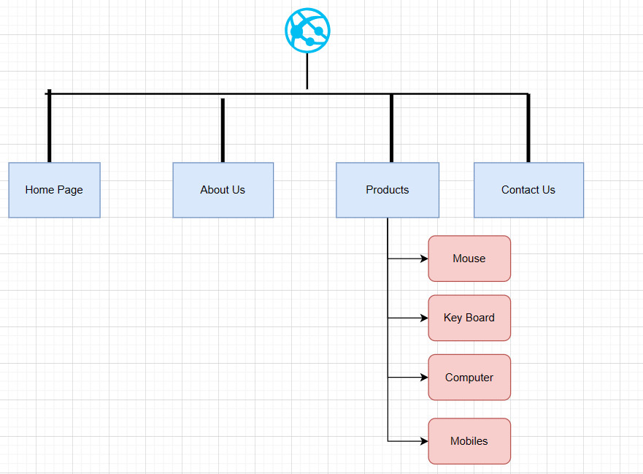
SITE'S MAP

Slide 6
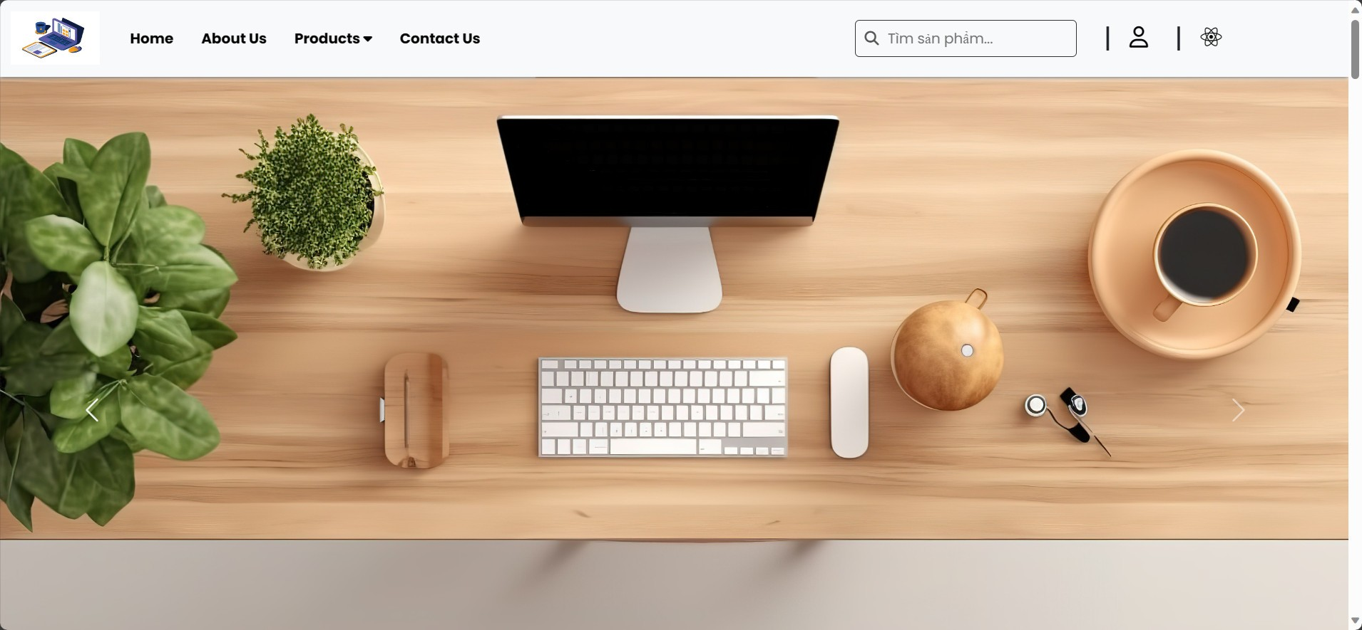
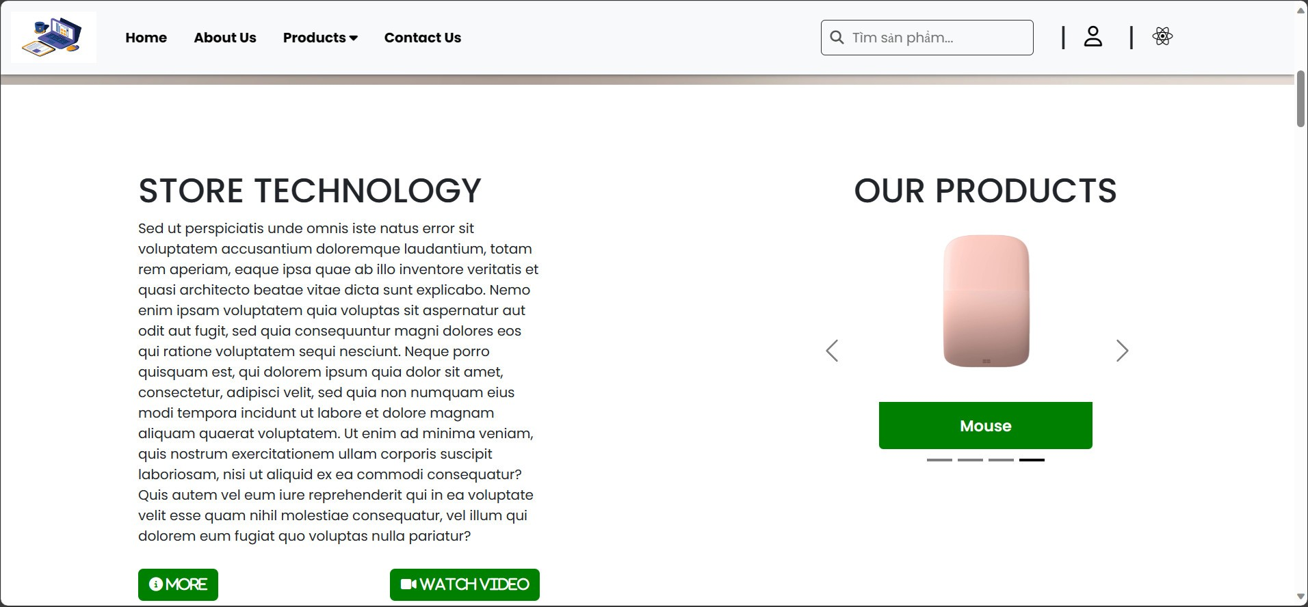
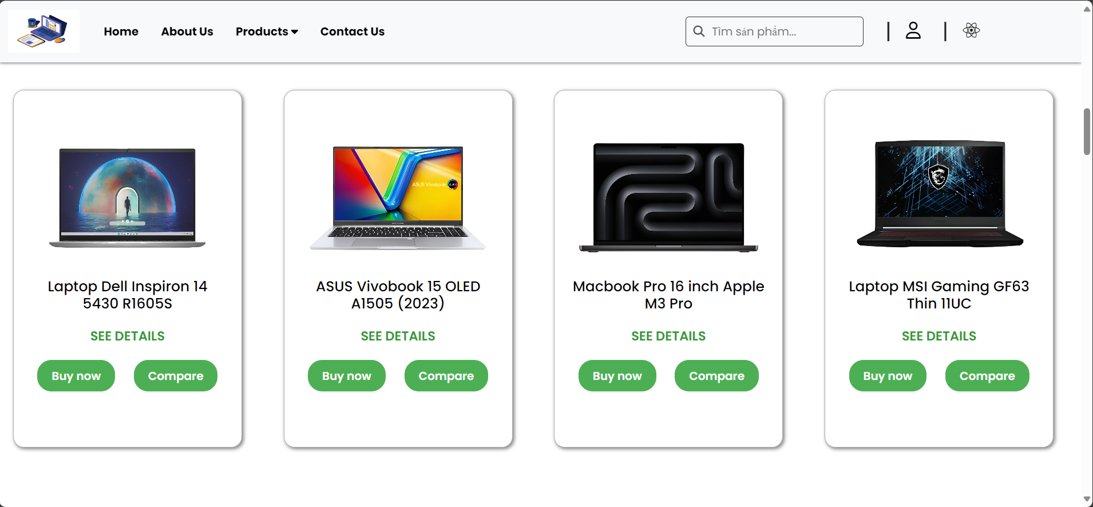
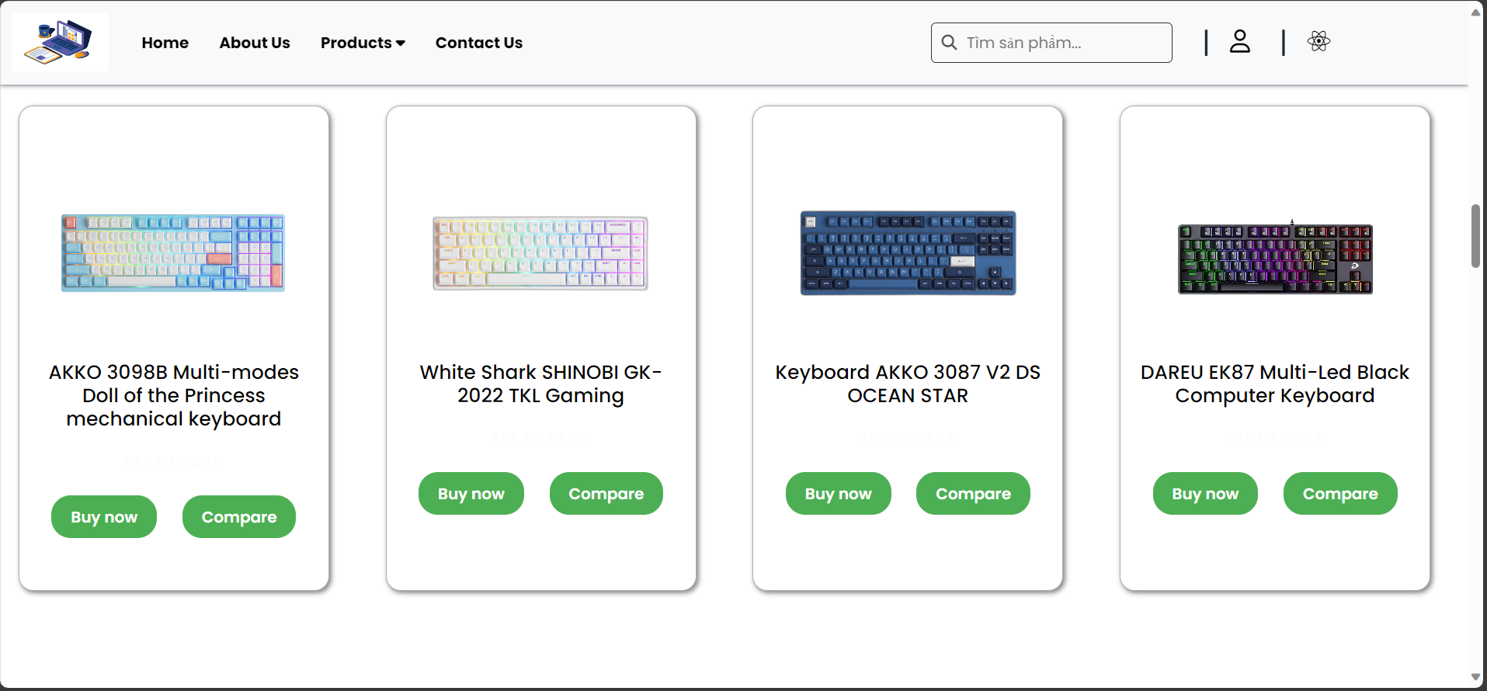
HOME PAGE

Slide 7
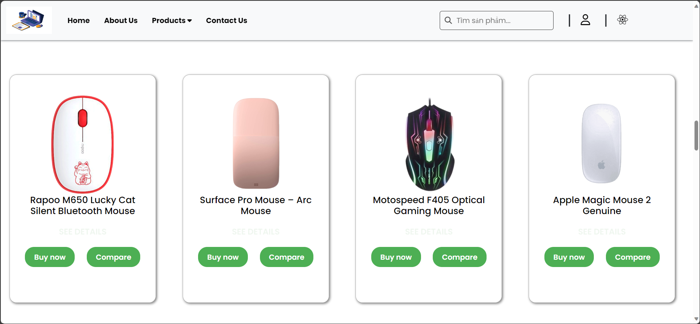
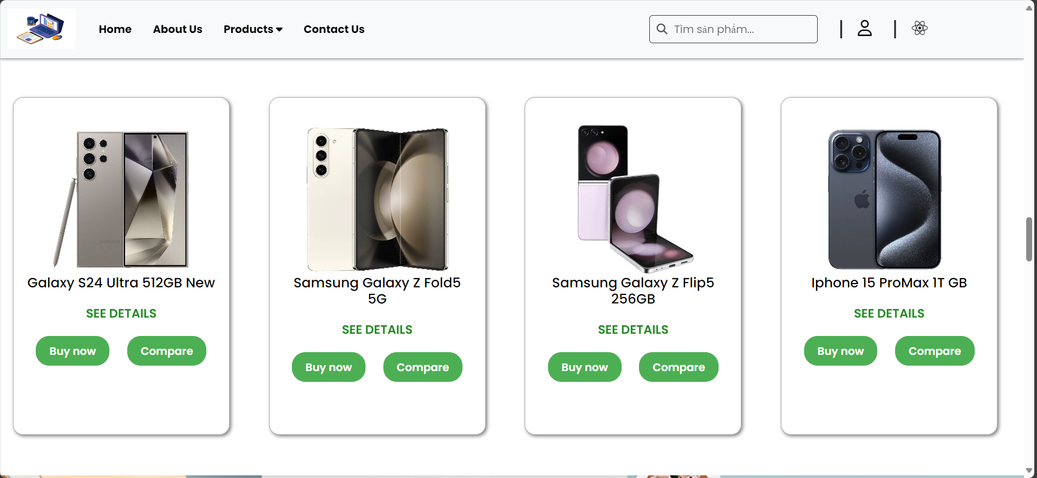
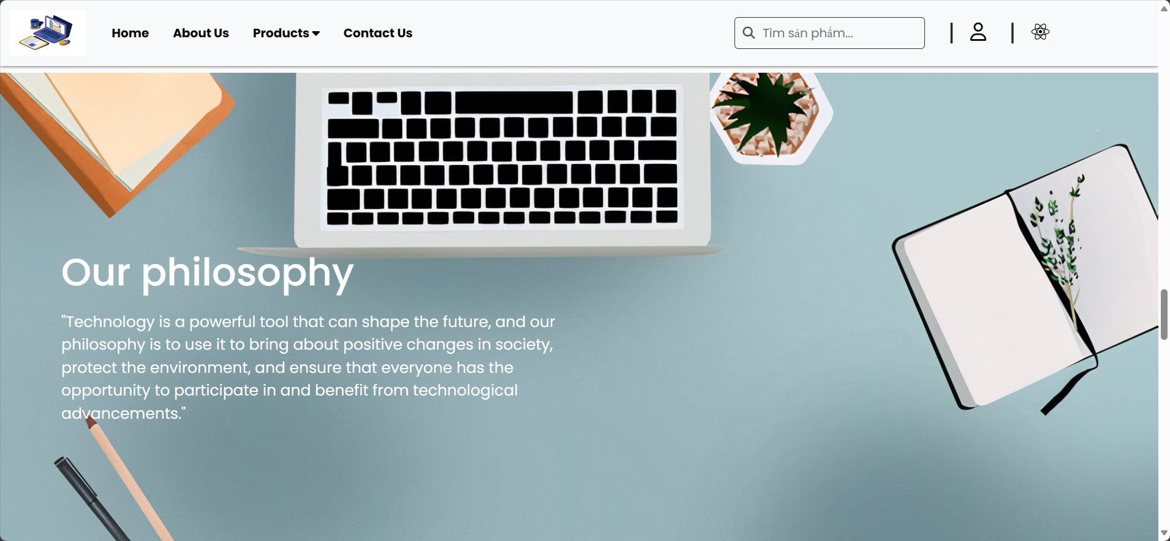
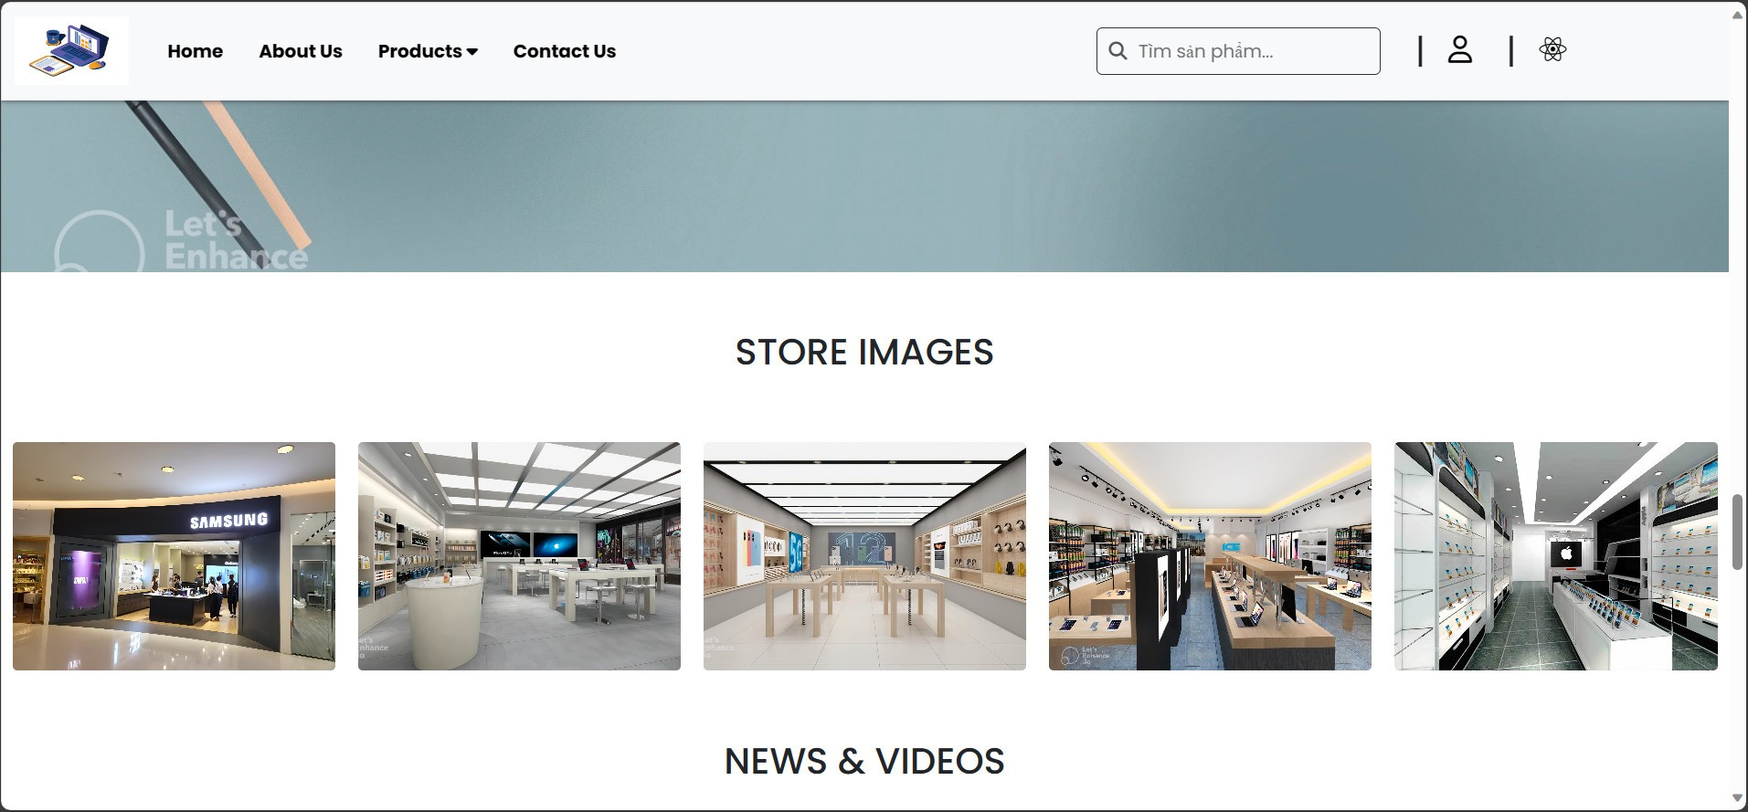
HOME PAGE

Slide 8
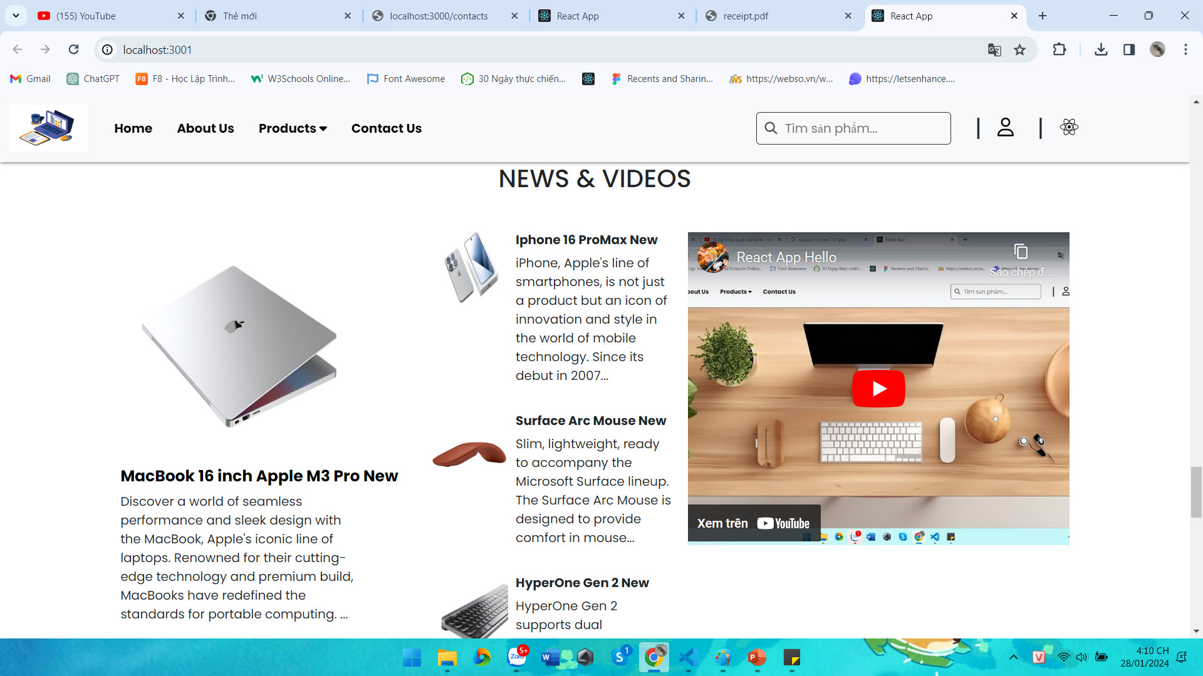
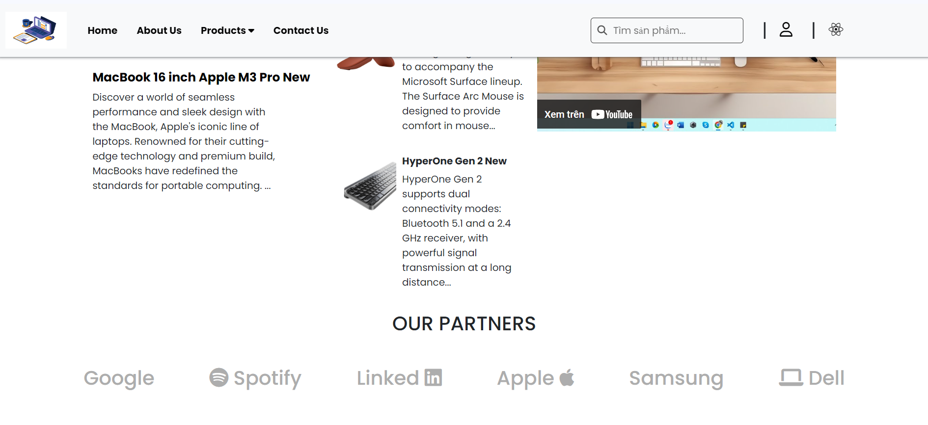
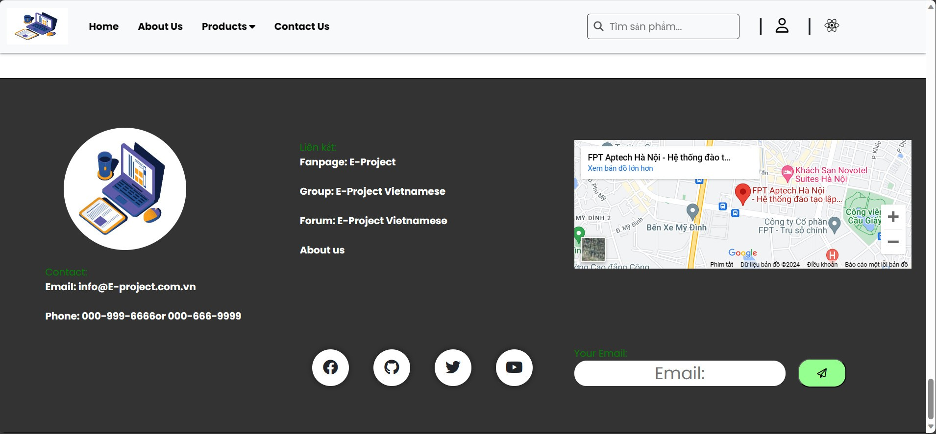
HOME PAGE

Slide 9
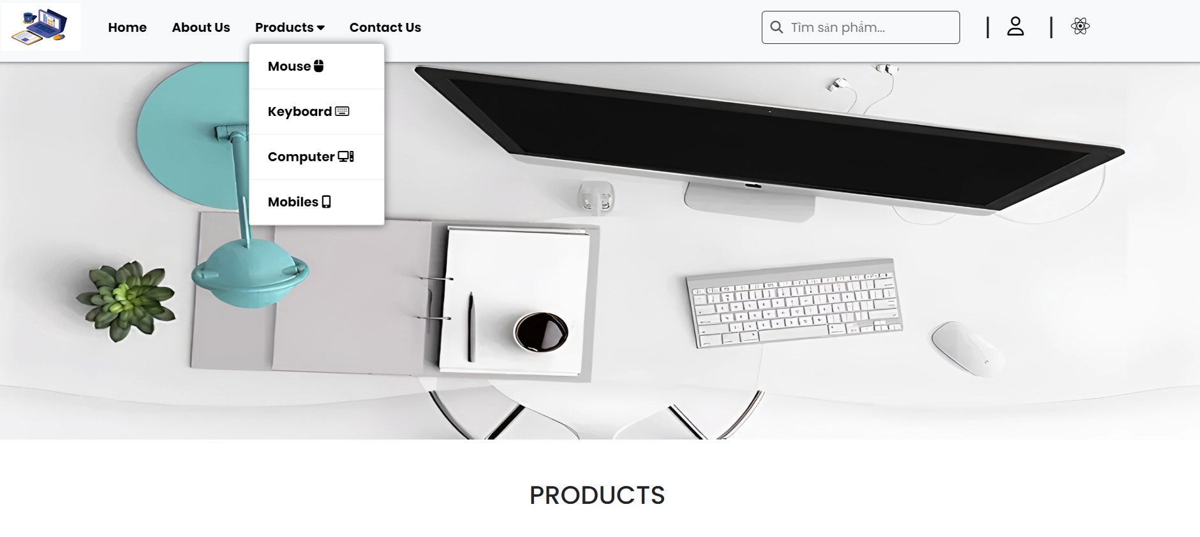
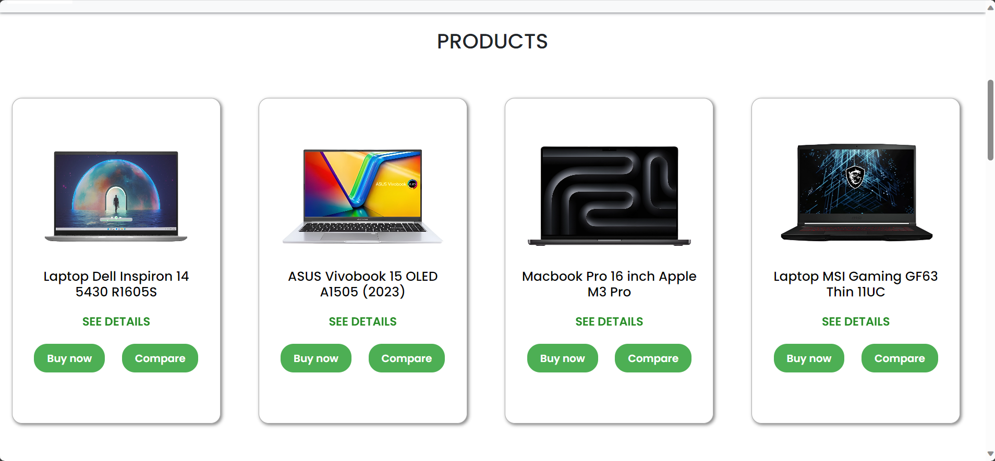
PRODUCT PAGE
We arrange displays to help customers easily observe products

Slide 10
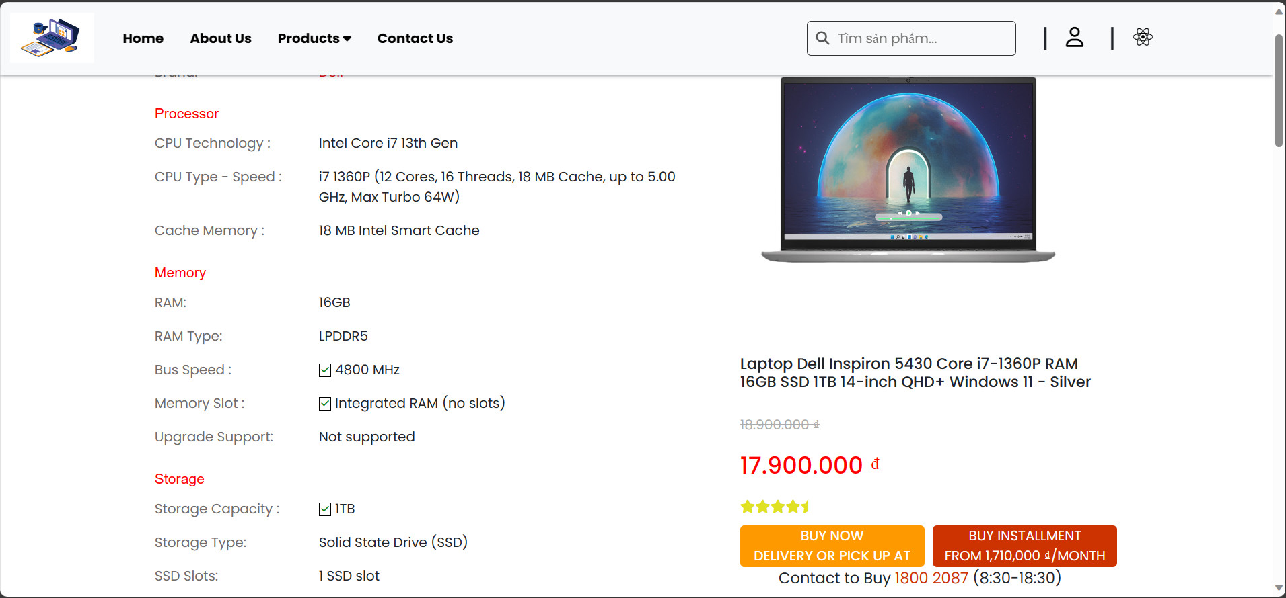
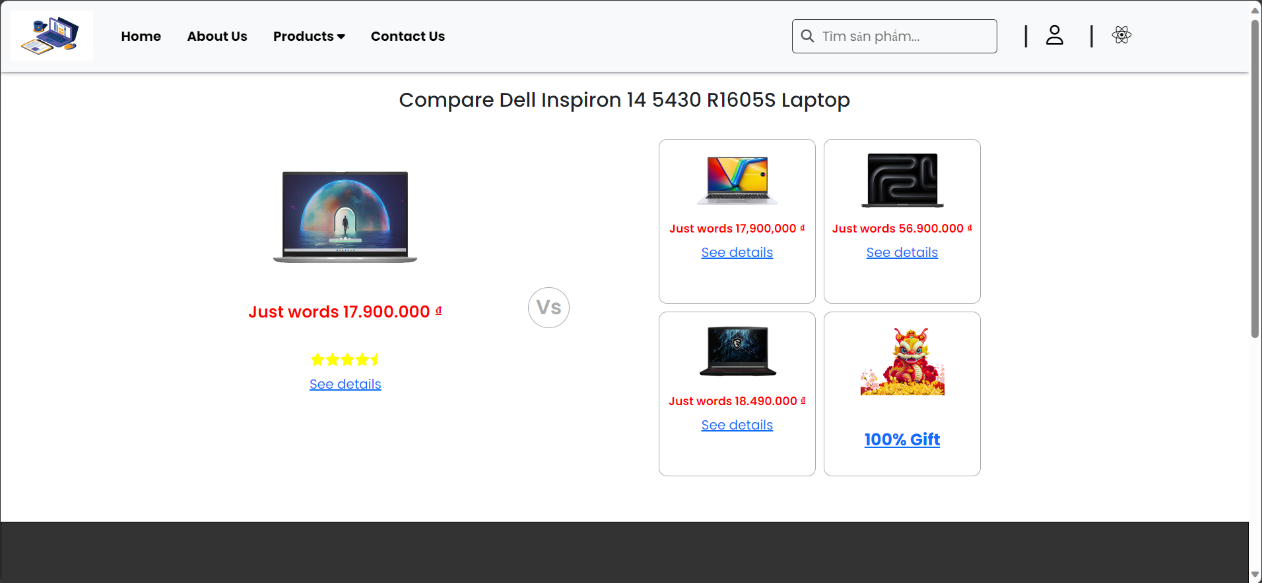
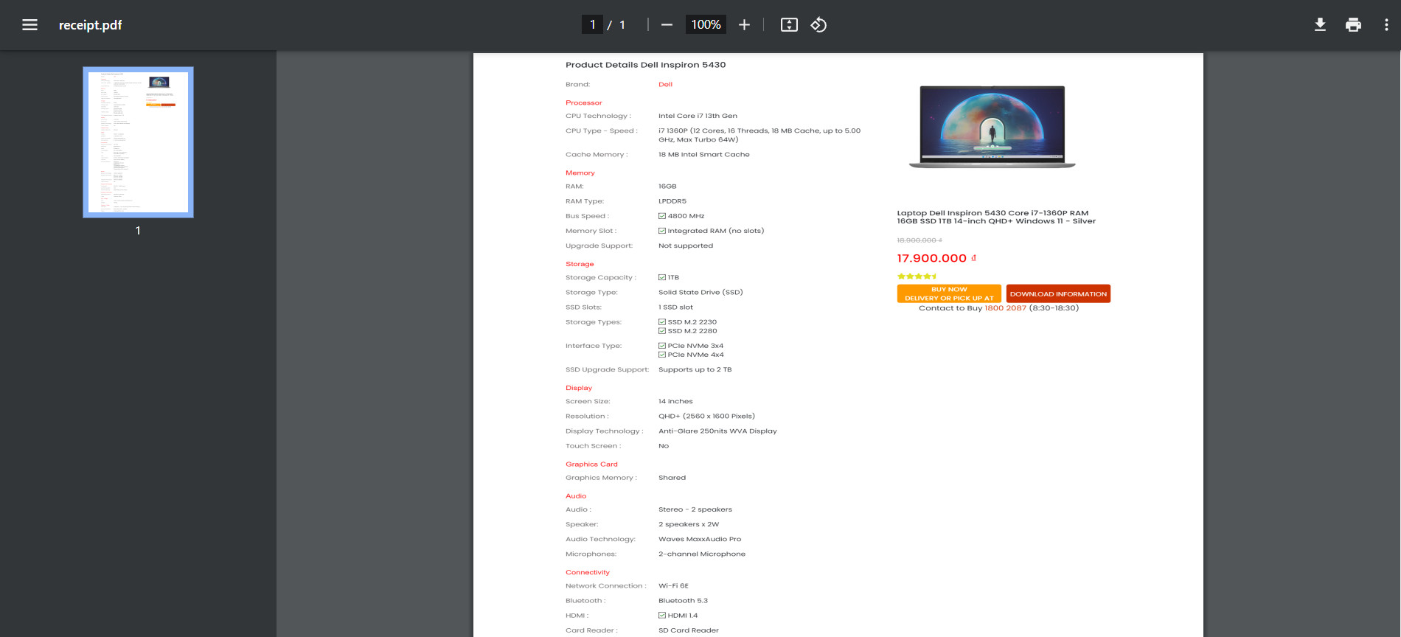
INDIVIDUAL PRODUCT PAGE
Displaying detailed information helps customers better understand products and make comparisons

Slide 11
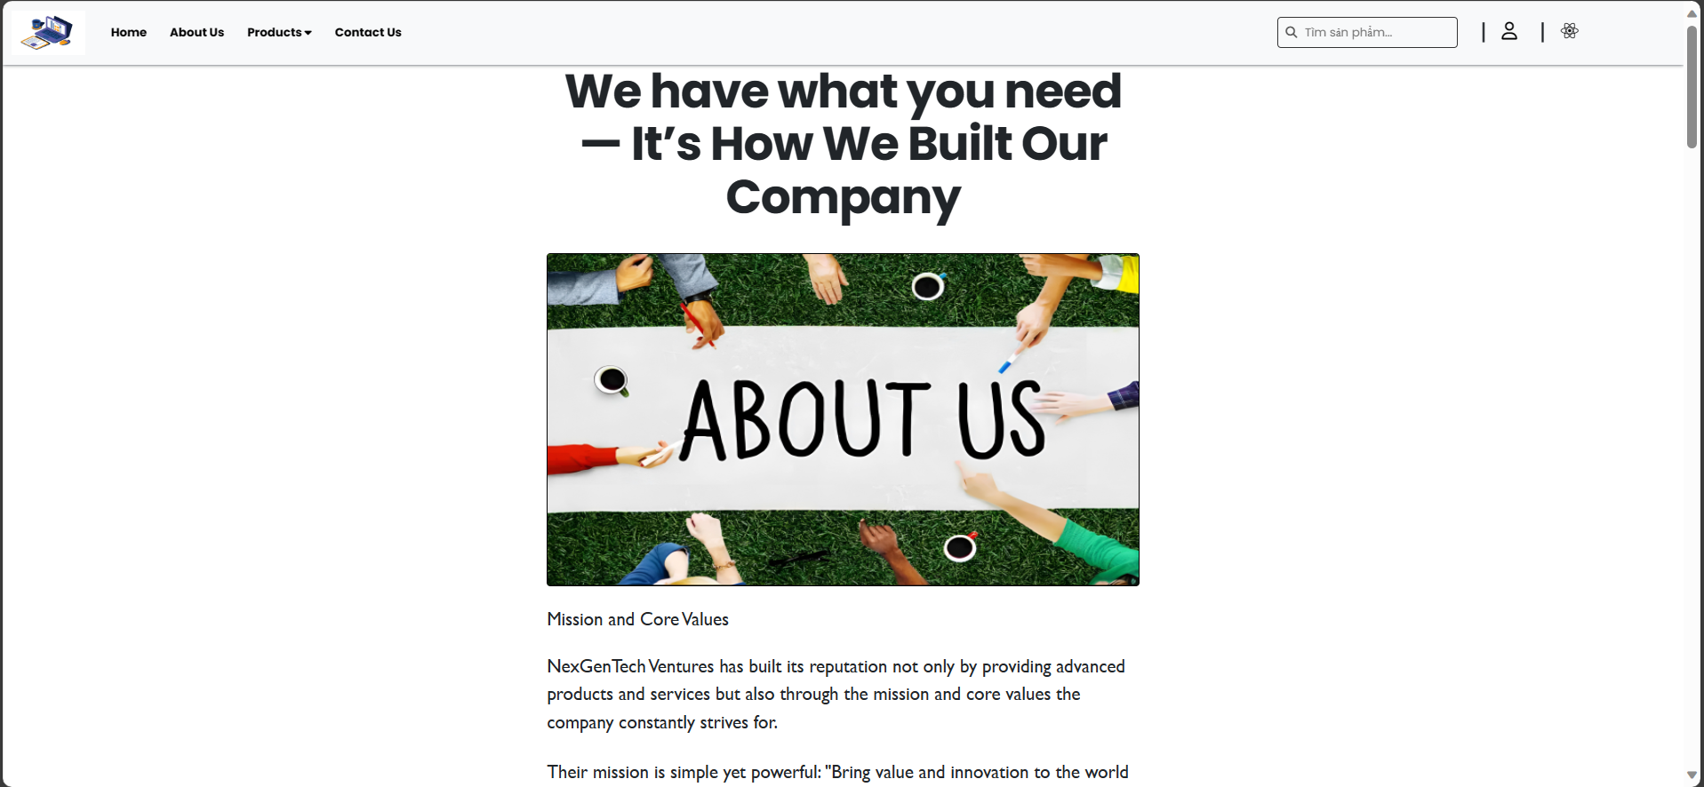
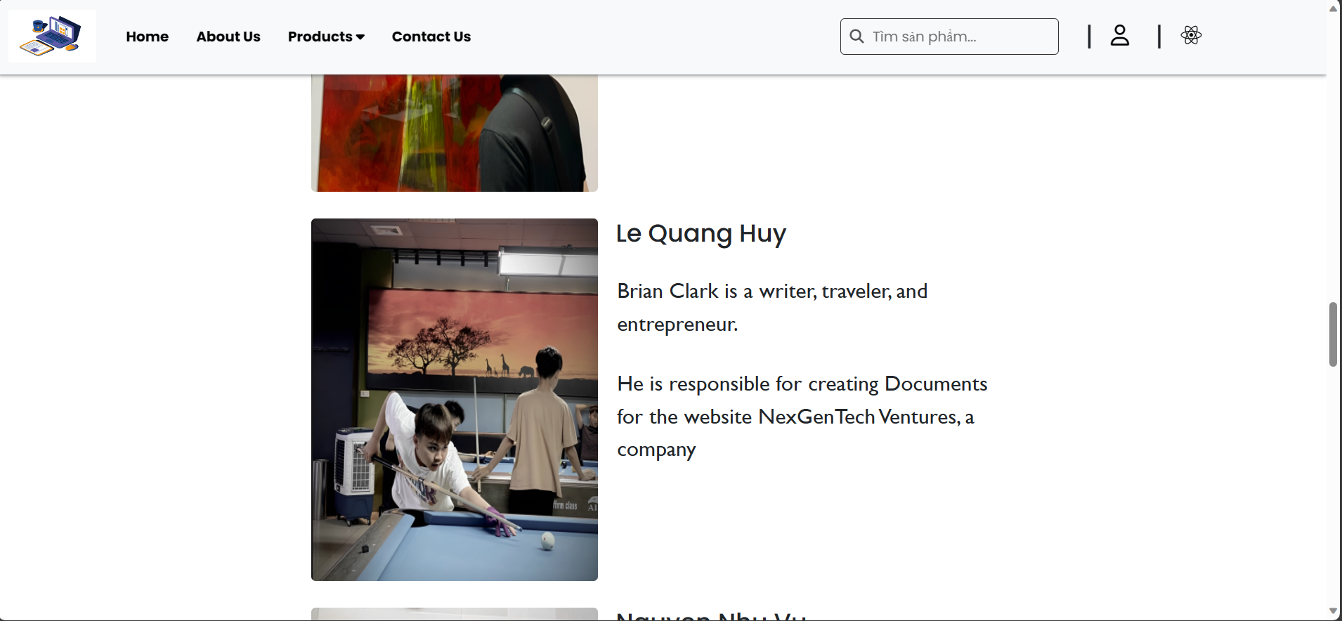
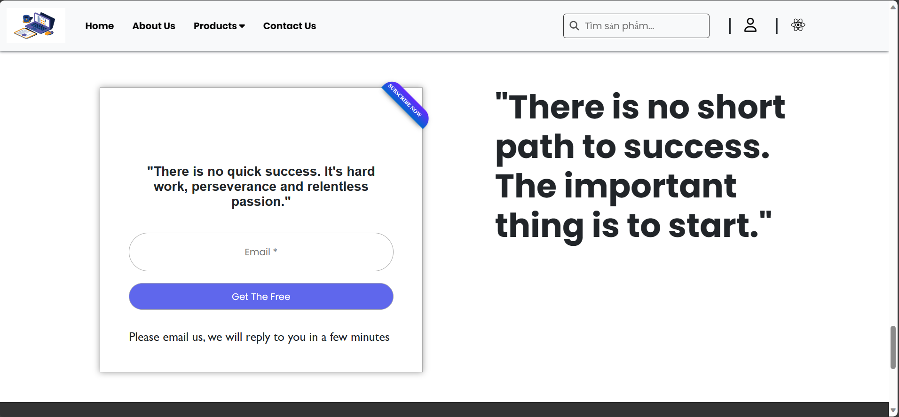
ABOUT US PAGE
Our company

Slide 12
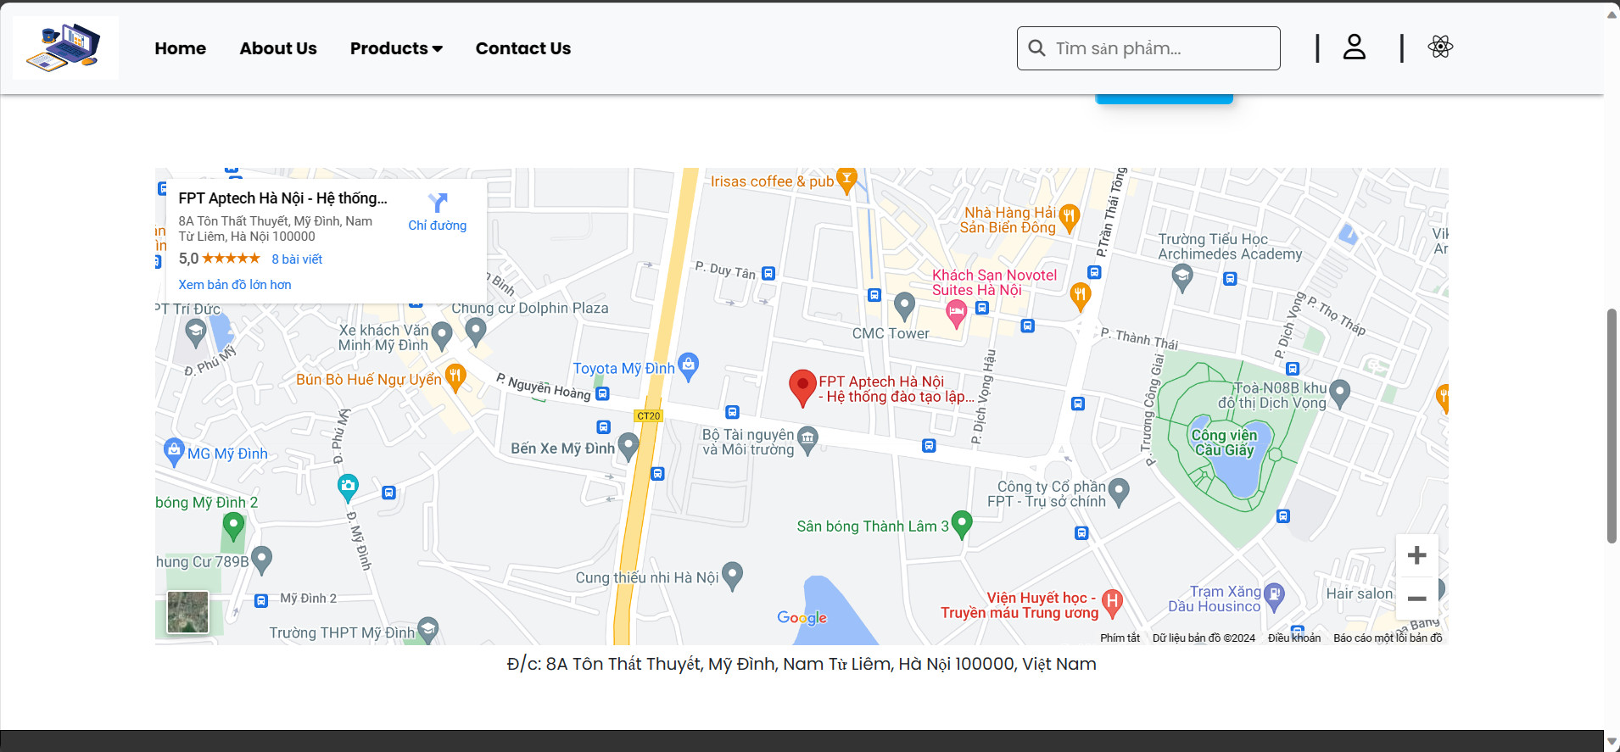
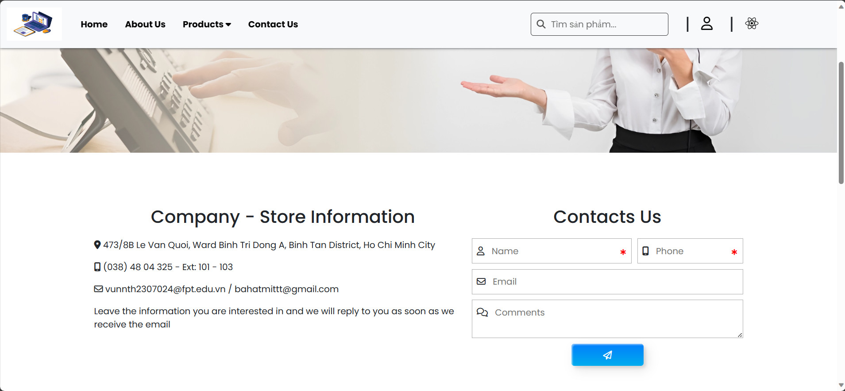
Showroom:
Our localtion.
Contact:
Company address and contact form.

Slide 13
Thank for listening!

